Slide 1
Leaf litter ecology continued
Goals for today:
Learn about the Siuslaw Model Forest and their management practices
Review literature and design your own experiments
Finalize plan for next week
Learn about earthworm ecology and ID
Review comments on 1st lab report

Slide 2
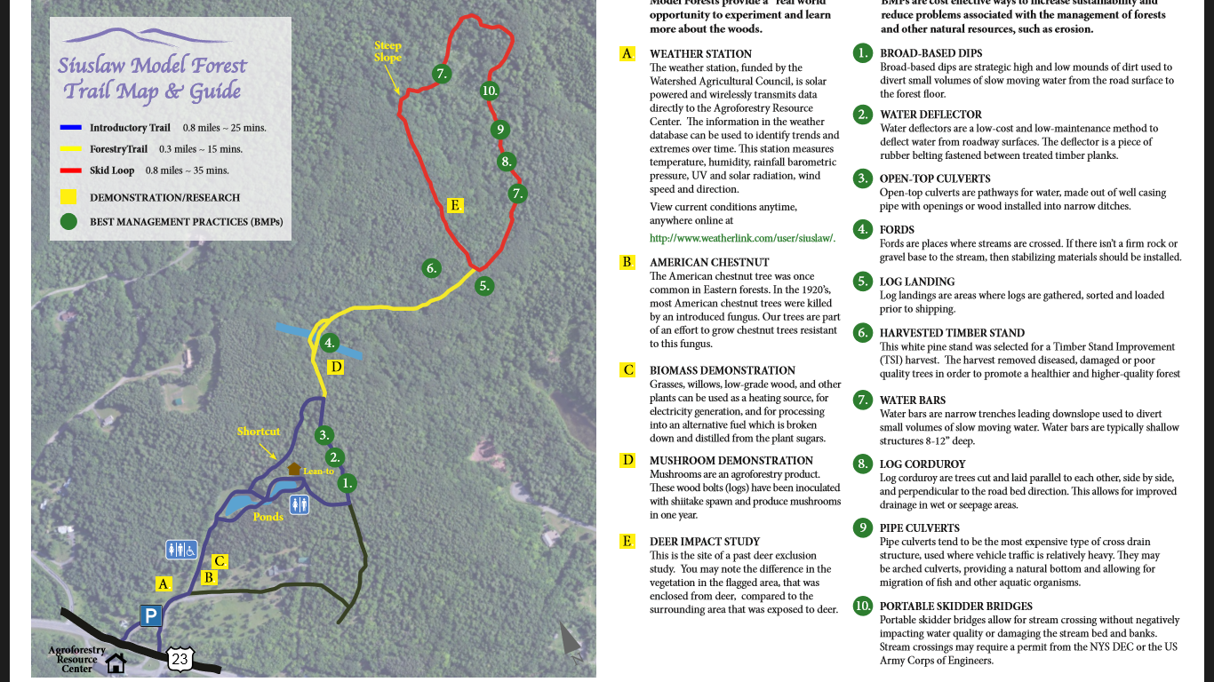
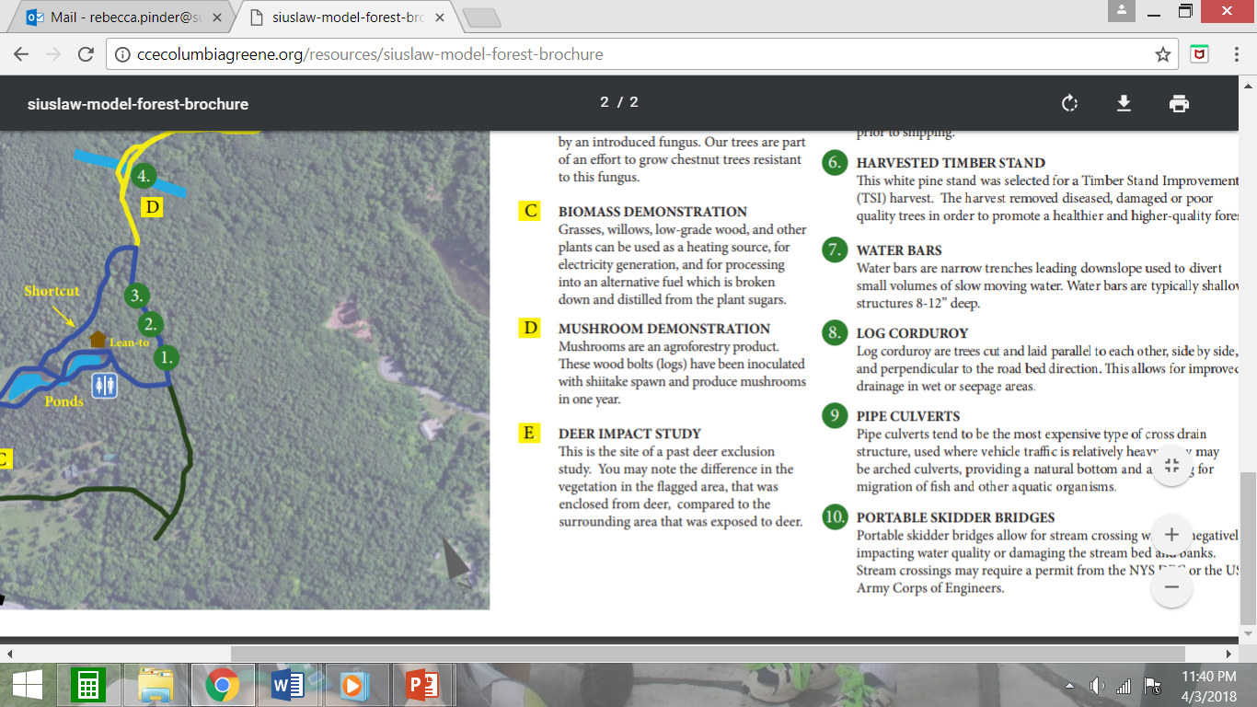
Siuslaw Model Forest: Managed by CCE Greene
Nearly 150 acres in Acra, name means “land of the far away river”
Managed for forest since 1956, family gave forest to CCE in 2006
2007 named Watershed Model Forest
Train Foresters, use BMP’s
Public outreach and research uses

Slide 3
Review of scientific method and its use in field studies
First step? Use of scientific papers in this process
Differences between controls in lab vs. field experiments
Read and discuss papers given to you
Identify their hypothesis
How did they test this hypothesis
Was this hypothesis supported?
Make a list of the major findings of each paper
Outline how you would set up an experiment testing the effects of deer on leaf litter invertebrates
Plan for next week

Slide 4
Earthworm Ecology
Potential to amplify effect of deer on other invertebrates?
Previous earthworm work
Earthworm species diversity at the Siuslaw Model Forest is unknown
Learn how to ID

Slide 5
Earthworm research past and present:
Darwin (1881)
The Formation of Vegetable Mould Through the Action of Worms, with Observations on Their Habitats
Agricultural
effect of practices on earthworm populations
ability of earthworms to improve soil
Waste management
removal of metals and toxins from soil

Slide 6
Research in forested ecosystems in the northern United States
Alteration of soil profile, nutrient cycling (Alban and Berry 1994, Groffman et al 2004)
Removal of litter, thinning of organic horizon
Mechanical disturbance-mixing layers
Reduced diversity in soil microarthropod communities (Migge 2001)
Loss of diversity in forest understory plants (Hale 2004, Nuzzo et al. 2009)

Slide 7
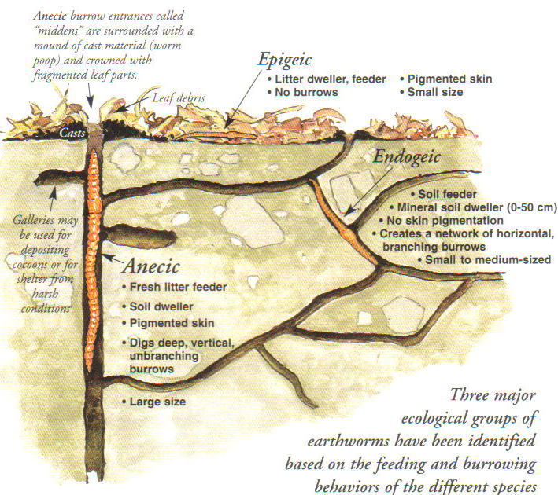
From Hale 2007

Slide 8
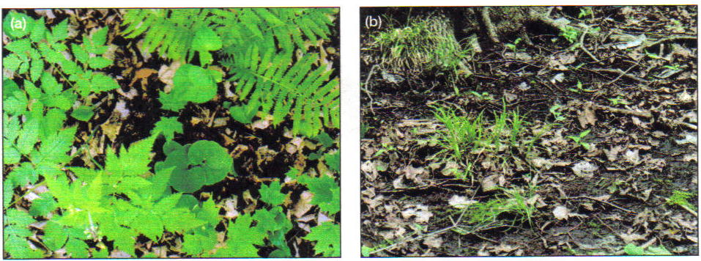
Effects of earthworms on understory
From Bohlen et al. 2004
Understory without earthworms
Understory with earthworms present

Slide 9
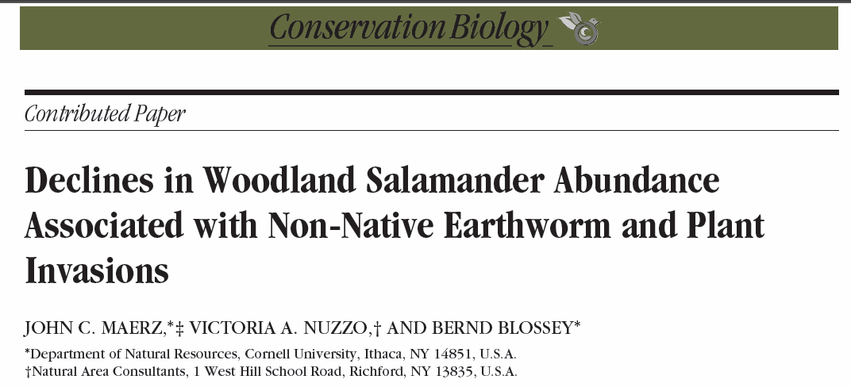
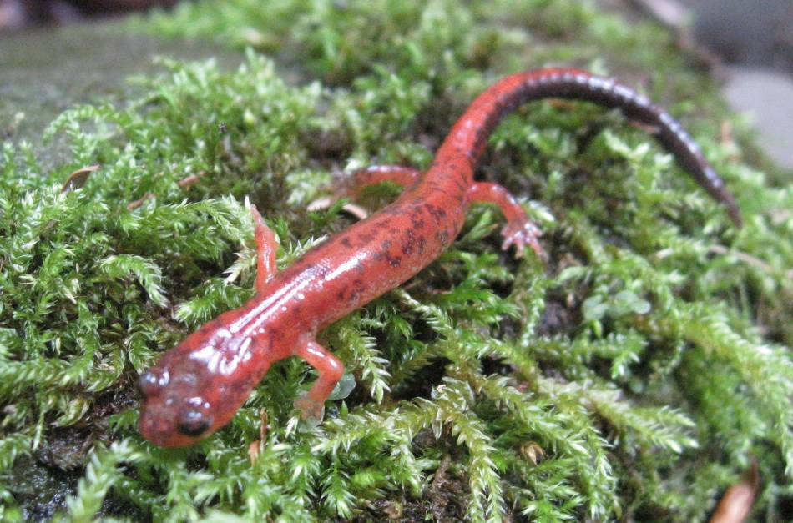
Kolozsvary 2008
Notes:
The most abundant vertebrate predator in the forest floor. They found that with decreasing leaf litter, salamander prey and abundance also decreased.
Here is where I talk about work in Ohio and how I was seeing worms
Salamander stuff in NY, transition from earthworm problem to my interests

Slide 10
Earthworm distribution in NYS
Combined field surveys with published reports
Compiled comprehensive species list for NYS
NYS is home to 31 species in three families: Lumbricidae, Megascolecidae, Sparganophilidae
Limited field work resulted in many new county records, including native species

Slide 11
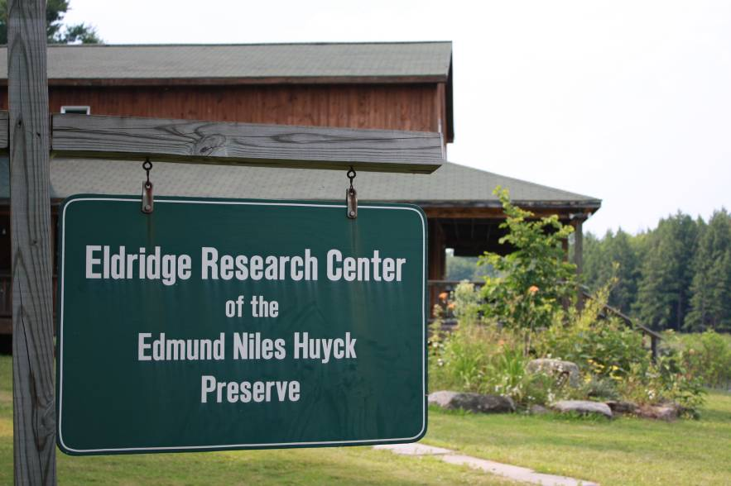
Study area: Helderberg Range (at the Edmund Niles Huyck Preserve)
800 Hectare preserve
Rich research history
Since 1931
http://www.huyckpreserve.org

Slide 12
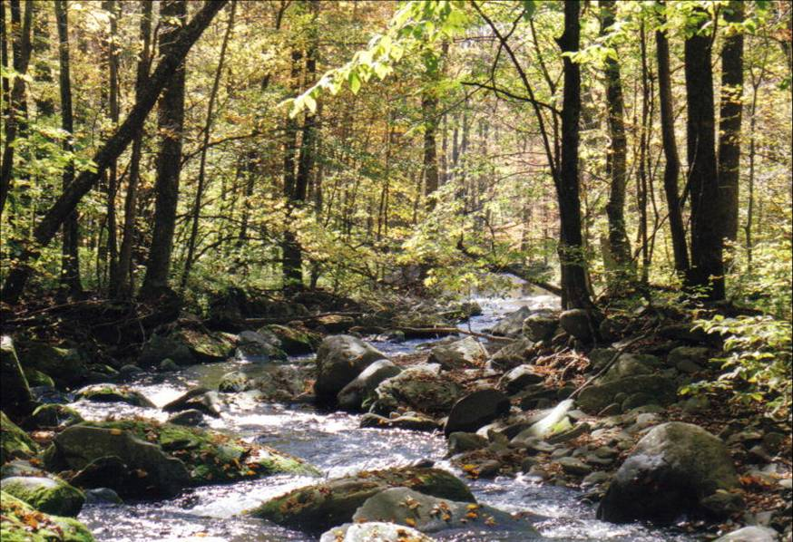
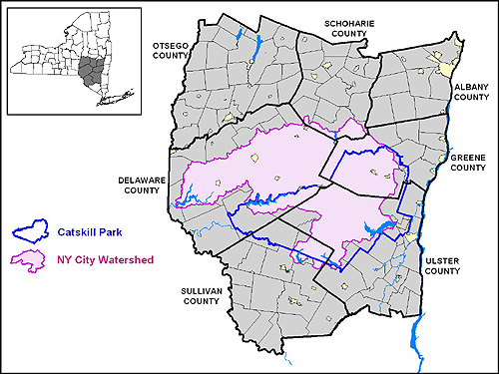
Study area: Catskill Park
~280,000 Hectares
Similar elevations and forest composition as Helderbergs
Different geological and land use histories despite proximity
www.catskillpark.org

Slide 13
14 sites: 7 in Helderbergs, 7 in Catskills
Visited 6 times over two years
Searched for one person hour per site, 50 m of stream reach
Collected over 2250 worms
Grevatt Road, Huyck Preserve

Slide 15
Earthworm assemblages along streambanks
Surveys validated presence of earthworms along a zone rich with salamanders
Are there patterns to earthworm assemblages based on region or measured environmental variables?
elevation, pH, number of tree species, % maple, % beech, % hemlock

Slide 16
Salamander
species
Tree
species
0.6
ALLCH
APOCA
OCTCY
EISTE
LUMTE
APOCO
EISFO
LUMRU
APORO
LUMCA
JUVLU
% beech
APOTB
JUVAP
JUVOV
OCTTY
DENRU
APOTU
pH
EISLO
% hemlock
APOTR
DENOC
% maple
APOLI
Elevation
-0.8
APOIC
-1.0
Environmental basis for pattern?
1.0

Slide 17
Summary of earthworm assemblages
Assemblages tend to vary by region
Weak evidence for species associations
within or between regions
Subset of species correlates with local environmental variables
Majority of earthworm species distributed randomly or associated with variables I did not examine
e.g., dispersal, land use history

Slide 18
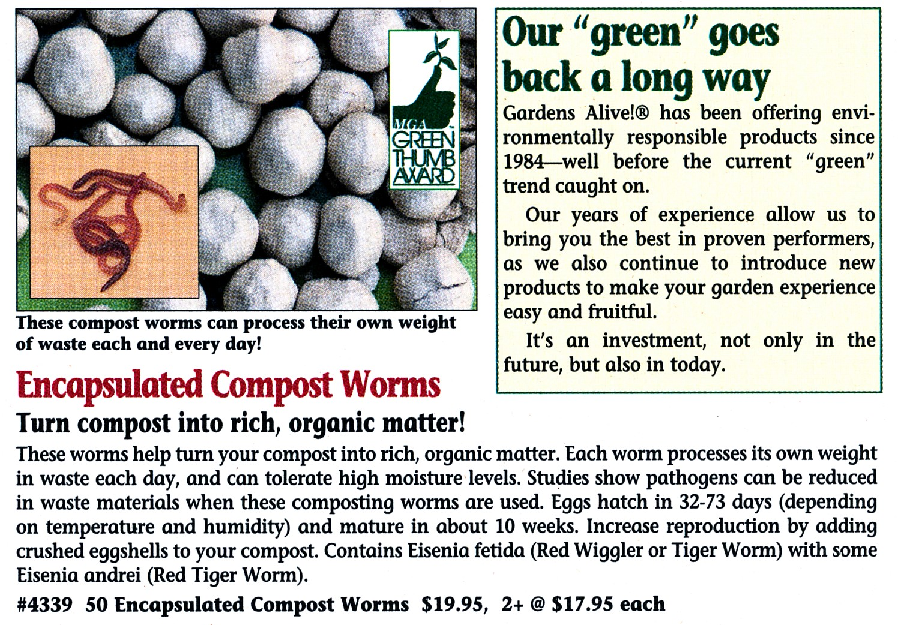

Slide 19
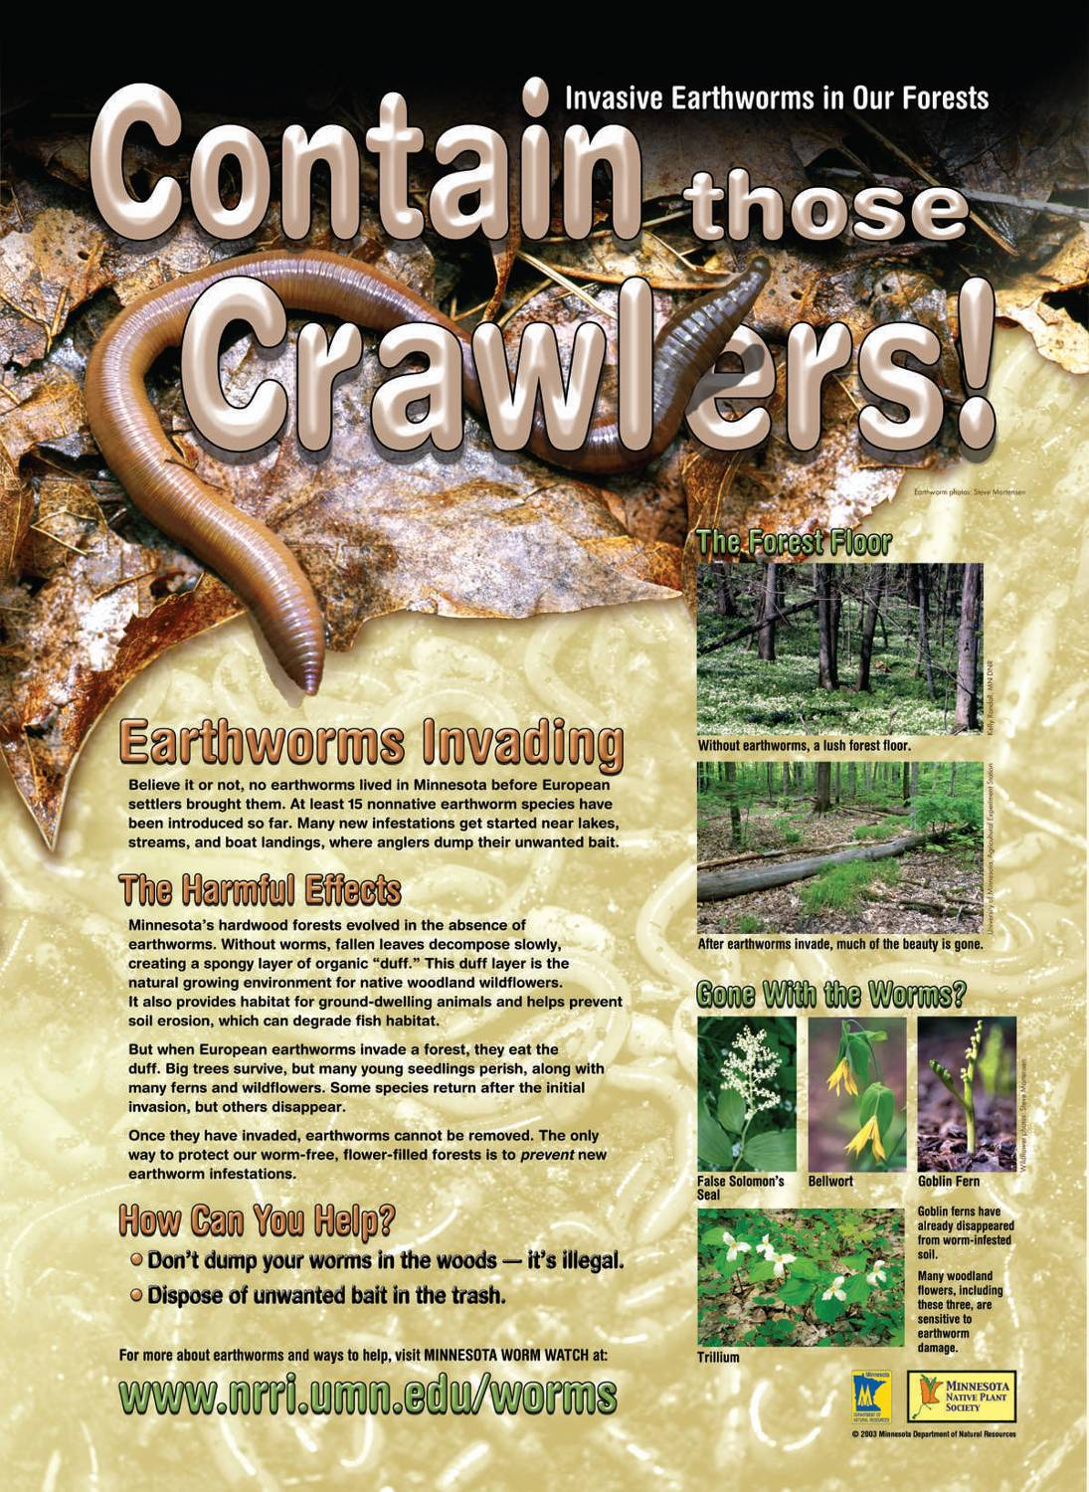

Slide 20
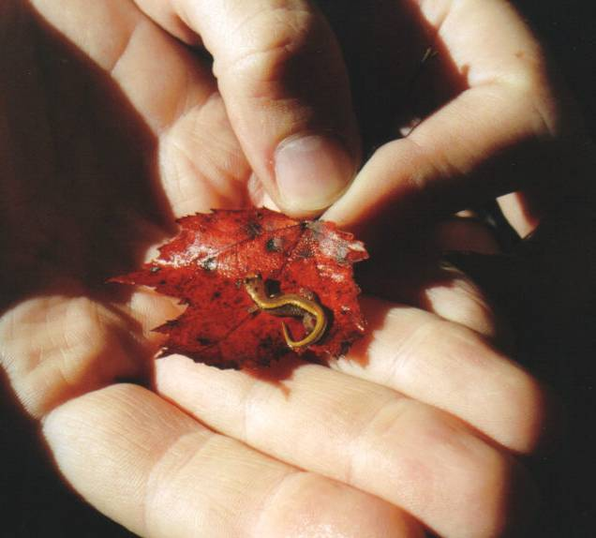
Do salamanders prey on earthworms? Are earthworms detrimental to salamanders?

Slide 21
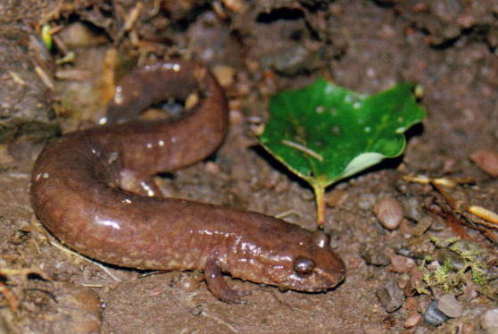
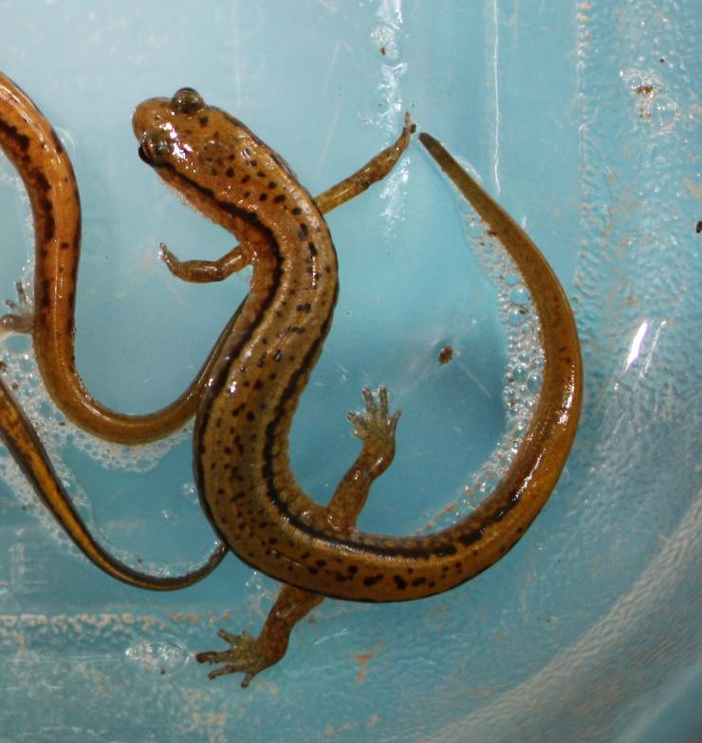
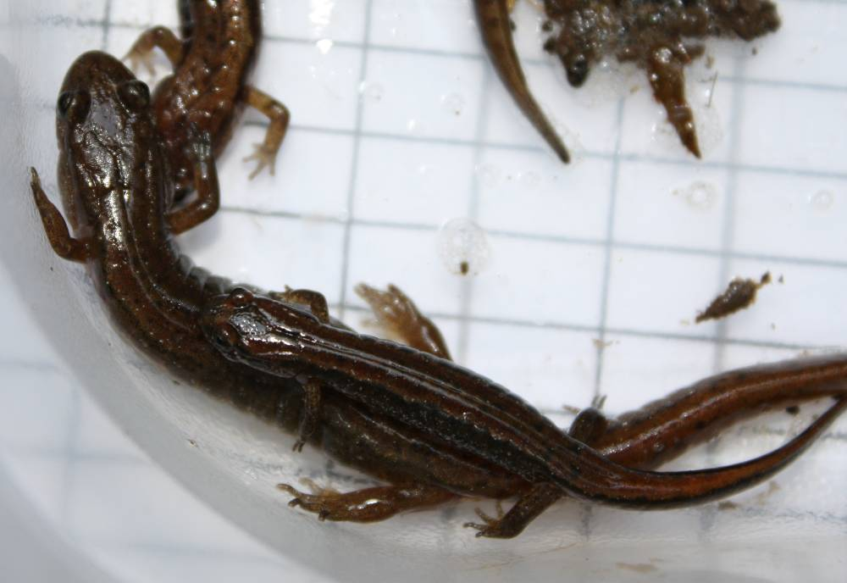
Kolozsvary 2008
Pinder 2006
Clockwise from top left: Spring, Red-backed, Dusky, and Two-lined salamanders
Pinder 2008
Pinder 2008

Slide 22
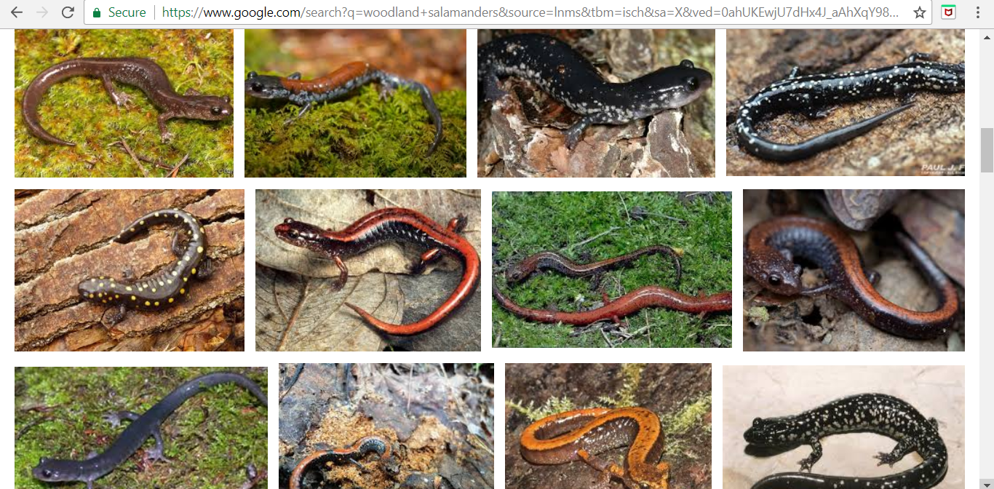

Slide 23
Hypotheses
Salamander diet includes earthworms in proportion to their abundance
If earthworms compete with detritivore prey, salamander diet would be different with respect to the presence of earthworms
Condition of salamanders is correlated with earthworm abundance

Slide 24
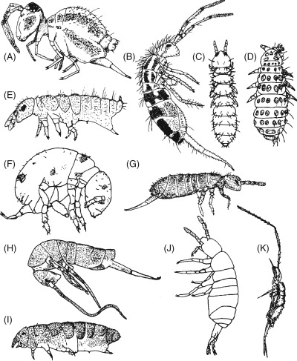
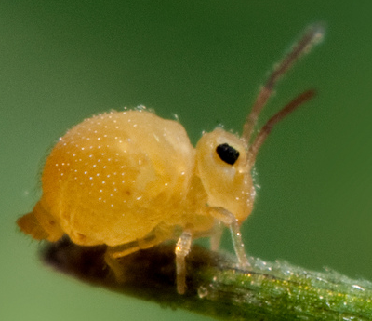
Tests: Salamander Diet Indices
Average number of prey items per gut
Ave. estimated dry mass of each gut
Amount of earthworms in diet (by count and mass)
Amount of Collembola in diet (by count and mass)
http://3.bp.blogspot.com/-hfOxClx_F5Y/UUMxs0VnWNI/AAAAAAAAAEM/nJnrp-i7I-8/s1600/6911717040_acd109a5bd_b.jpg
https://ars.els-cdn.com/content/image/3-s2.0-B9780123741448000643-gr1.jpg

Slide 25
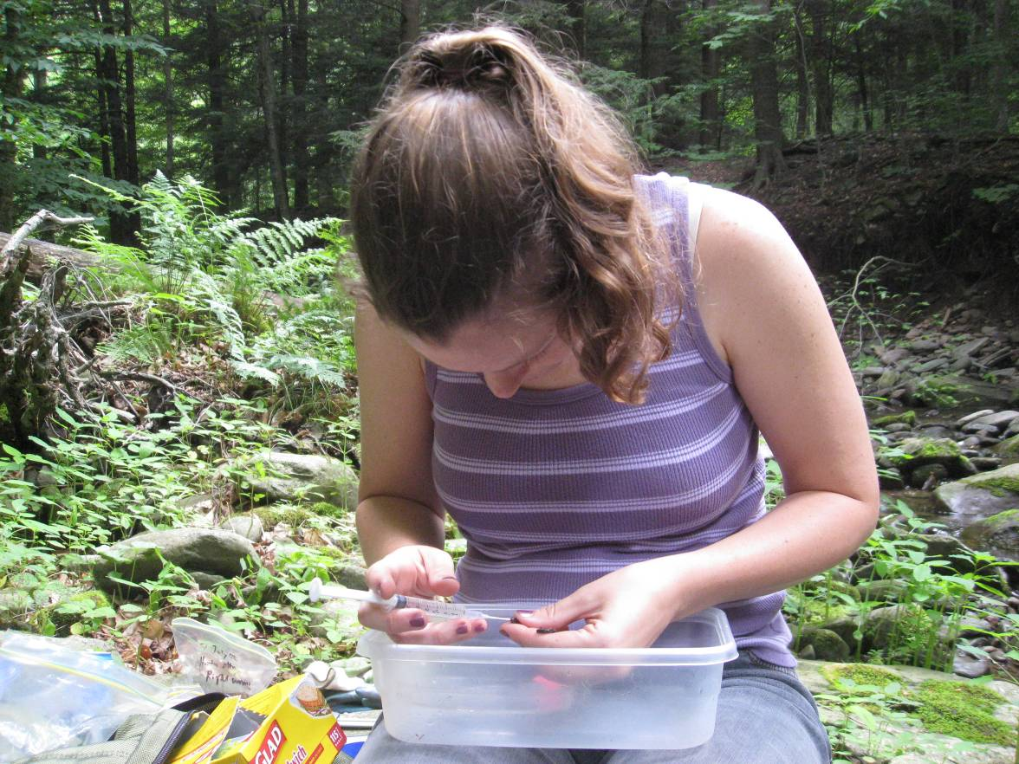
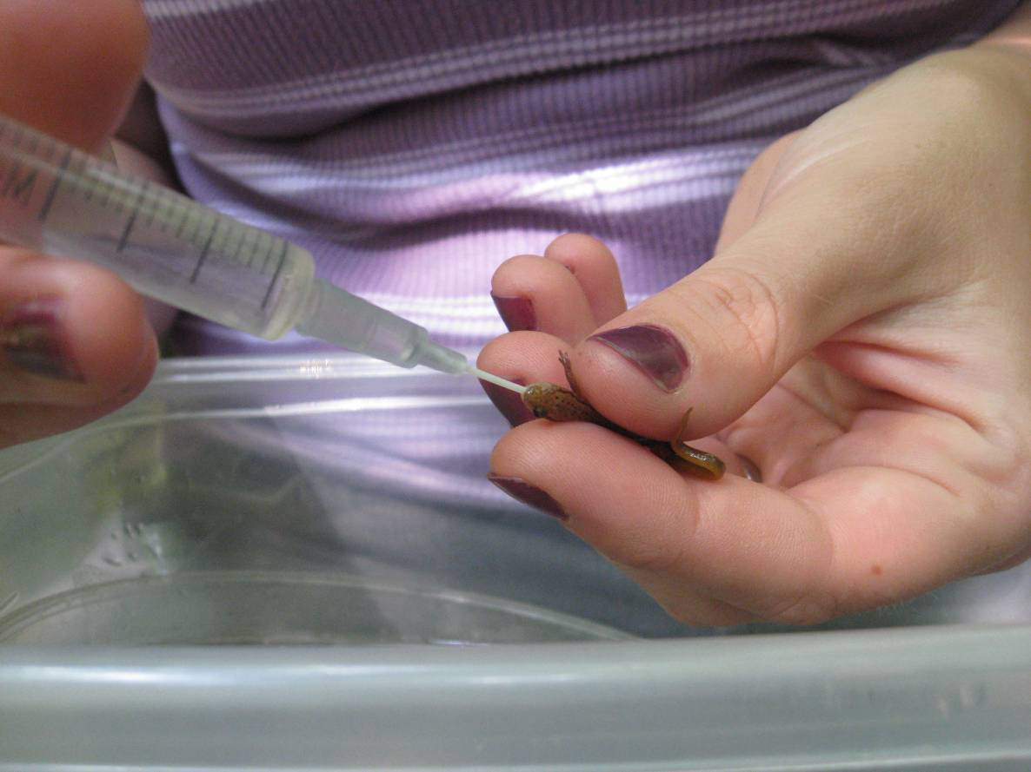

Slide 26
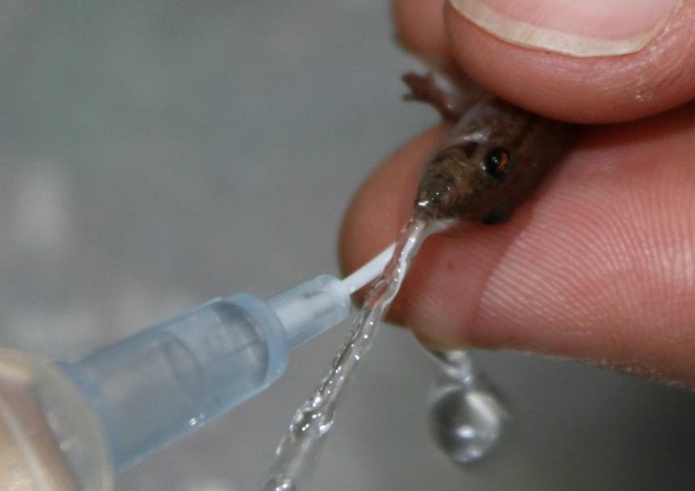

Slide 27
Summary of stomach contents
Obtained 391 gut contents samples
from P. cinereus, G. porphyriticus, E. bislineata and Desmognathus sp.
Main prey items:
Collembola (28% count, 3% mass)
Mites (14% count, 2% mass)
Diptera (mostly larvae, 8.9% count, 7.8% mass)
Debris (7.5% count, 18% mass)
Lepidoptera (1.3% count, 26% mass)
Earthworms (1.4 % count, 3.2% mass)

Slide 28
Salamander diet and earthworm variables
Amount of prey, % Collembola, % earthworm prey of E. bislineata was not associated with any of the earthworm variables
Number of prey items found per Desmognathus spp. guts was negatively correlated with the biomass of Octolasion tyrtaeum (p = 0.02)

Slide 29
Tests: Salamander Condition Indices
Body condition
residuals of mass-SVL regressions
Tail condition
residuals of head size versus tail volume

Slide 30
Evidence of parallel diversity patterns

Slide 31
Body and Tail Condition of Salamanders and their relationship with earthworm variables measured
Neither tail or body condition of E. bislineata were related to measured earthworm variables
Body condition of Desmognathus spp. was significantly correlated with the number of earthworms per site, the biomass per site, and the diversity of earthworms per site (all p < 0.02)

Slide 32
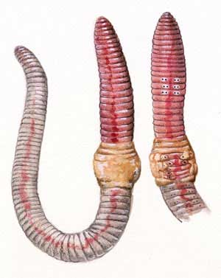
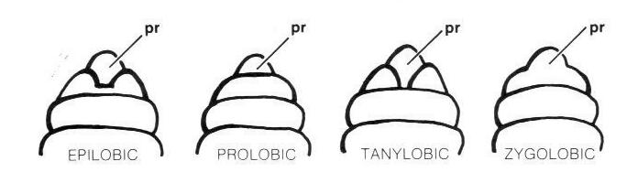
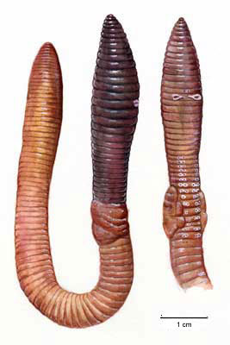

Four types of prostomiums
←Aporrectodea rosea
Lumbricus terrestris →
Types of setal pairings
Notes:
All those worms had to be identified. Most were identified to species, some to genus if they were juveniles
Briefly go into how to id earthworms as a segway to next slide

